Slide 1


AtliQ Grands: Dashboarding Project
Interactive dashboards for data-driven decisions.
by karthik pv

Slide 2

Problem Statement
Losing Market Share
Ineffective Decisions
AtliQ Grands faces increasing competition.
Strategic decisions are not data-driven.
Objective
Create dashboard for performance monitoring.

Slide 3
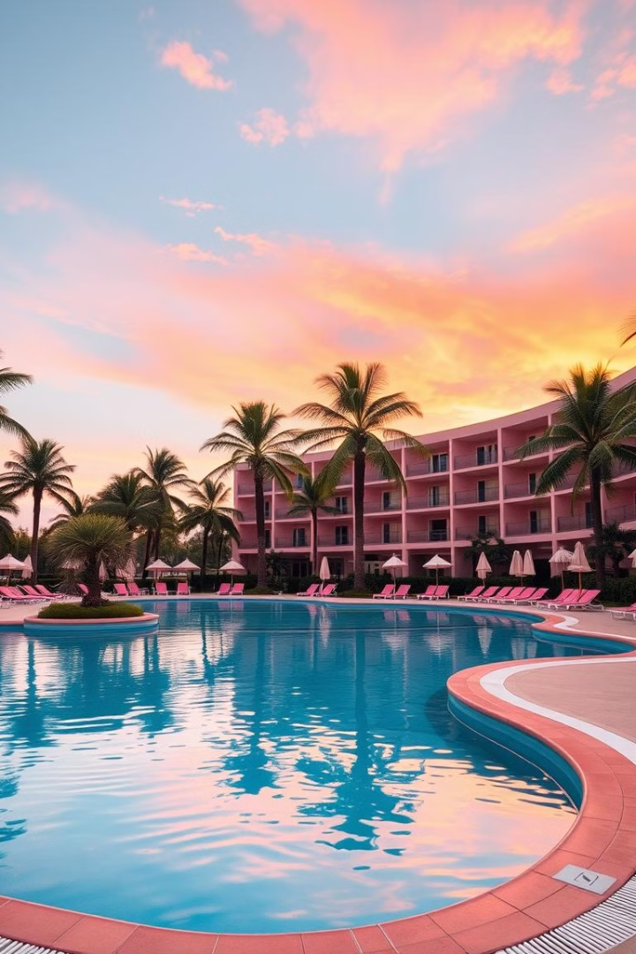
Project Scope
1
Revenue Analysis
2
Occupancy Trends
Focus on revenue realized and booking platforms.
Monitor occupancy rates and room category performance.
3
Additional KPIs
Address Revenue , ADR, DSRN, RevPar, Occupation% , Realisation%
and other measures.

Slide 4






Data Source – codebasics.com
List of Tables
fact_bookings
dim_hotels
dim_rooms
dim_date
Booking details and revenue.
Hotel metadata and locations.
Room classifications.
Date-related dimensions and attributes.
fact_aggregated_bookings
Summarized booking metrics and analytics.

Slide 5
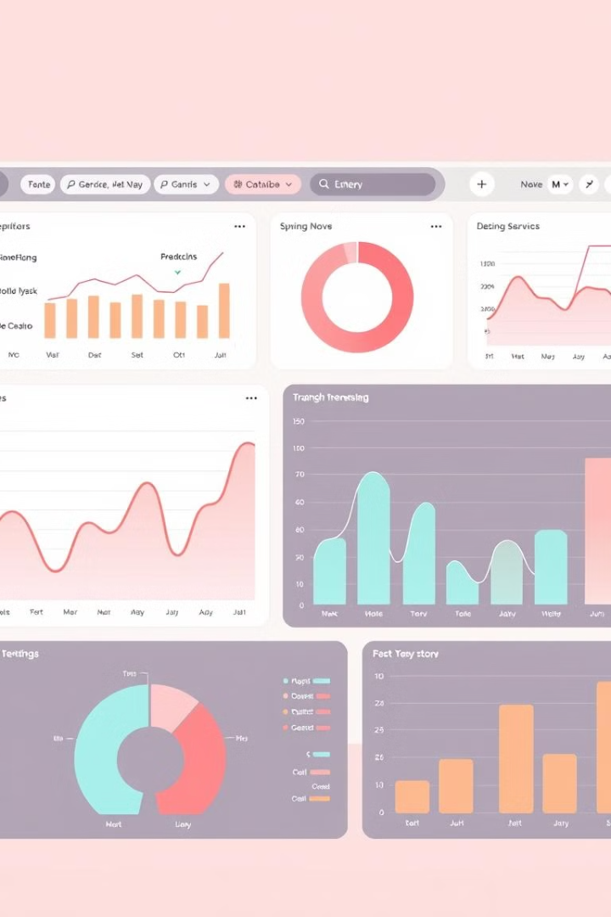



Methodology
Data Preparation
Integrate data from multiple tables.
Dashboard Design
Incorporate stakeholder inputs i.e the key measures
Interactivity
Enable filtering and drill-downs.

Slide 6
Key Performance Indicators (KPIs)
Sno. | Calculated Column Name | Description / Purpose | DAX formula | Table
1 | wn | To get the week number from the corresponding date. | wn = WEEKNUM(dim_date[date]) | dim_date
2 | day type | Based on the feedback from stakeholder, we considered Friday and Saturday as weekend and weekdays from Sunday to Thurdsay. In PowerBI, Sunday weekday number is 1, Monday is 2 and so on. So, if weekday number is greater than 5, then weekend or else weekday. | day type = Var wkd = WEEKDAY(dim_date[date],1) return IF( wkd>5,"Weekend","Weekday") | dim_date
Sno | Measures | Description / Purpose | DAX FORMULA | TABLE
1 | Revenue | To get the total revenue_realized | Revenue = SUM(fact_bookings[revenue_realized]) | fact_bookings
2 | Total Bookings | To get the total number of bookings happened | Total Bookings = COUNT(fact_bookings[booking_id]) | fact_bookings
3 | Total Capacity | To get the total capacity of rooms present in hotels | Total Capacity = SUM(fact_aggregated_bookings[capacity]) | fact_aggregated_bookings
4 | Total Succesful Bookings | To get the total succesful bookings happened for all hotels | Total Succesful Bookings = SUM(fact_aggregated_bookings[successful_bookings]) | fact_aggregated_bookings
5 | Occupancy % | Occupancy means total successful bookings happened to the total rooms available(capacity) | Occupancy % = DIVIDE([Total Succesful Bookings],[Total Capacity],0) | fact_aggregated_bookings
6 | Average Rating | Get the average ratings given by the customers | Average Rating = AVERAGE(fact_bookings[ratings_given]) | fact_bookings
7 | No of days | To get the total number of days present in the data. In our case, we have data from May to July. So 92 days. | No of days = DATEDIFF(MIN(dim_date[date]),MAX(dim_date[date]),DAY) +1 | dim_date
8 | Total cancelled bookings | To get the"Cancelled" bookings out of all Total bookings happened | Total cancelled bookings = CALCULATE([Total Bookings],fact_bookings[booking_status]="Cancelled") | fact_bookings
9 | Cancellation % | calculating the cancellaton percentage. | Cancellation % = DIVIDE([Total cancelled bookings],[Total Bookings]) | fact_bookings
10 | Total Checked Out | To get the successful 'Checked out' bookings out of all Total bookings happened | Total Checked Out = CALCULATE([Total Bookings],fact_bookings[booking_status]="Checked Out") | fact_bookings
11 | Total no show bookings | To get the"No Show" bookings out of all Total bookings happened ("No show" means those customers who neither cancelled nor attend to their booked rooms) | Total no show bookings = CALCULATE([Total Bookings],fact_bookings[booking_status]="No Show") | fact_bookings
12 | No Show rate % | calculating the no show percentage. | No Show rate % = DIVIDE([Total no show bookings],[Total Bookings]) | fact_bookings

Slide 7
13 | Booking % by Platform | To show the percentage contribution of each booking platform for bookings in hotels. We have booking platforms like makeyourtrip, logtrip, tripster etc) | Booking % by Platform = DIVIDE([Total Bookings], CALCULATE([Total Bookings], ALL(fact_bookings[booking_platform]) ))*100 | fact_bookings
14 | Booking % by Room class | To show the percentage contribution of each room class over total rooms booked. We have room classes like Standard, Elite, Premium, Presidential. | Booking % by Room class = DIVIDE([Total Bookings], CALCULATE([Total Bookings], ALL(dim_rooms[room_class]) ))*100 | fact_bookings, dim_rooms
15 | ADR | Calculate the ADR(Average Daily rate) It is the ratio of revenue to the total rooms booked/sold. It is the measure of the average paid for rooms sold in a given time period | ADR = DIVIDE( [Revenue], [Total Bookings],0) | fact_bookings
16 | Realisation % | calculate the realisation percentage. It is nothing but the succesful "checked out" percentage over all bookings happened. | Realisation % = 1- ([Cancellation %]+[No Show rate %]) | fact_bookings
17 | RevPAR | Calculate the RevPAR(Revenue Per Available Room) RevPAR represents the revenue generated per available room, whether or not they are occupied. RevPAR helps hotels measure their revenue generating performance to accurately price rooms. RevPAR can help hotels measure themselves against other properties or brands. | RevPAR = DIVIDE([Revenue],[Total Capacity]) | fact_bookings, fact_agg_bookings
18 | DBRN | calculate DBRN(Daily Booked Room Nights) This metrics tells on average how many rooms are booked for a day considering a time period | DBRN = DIVIDE([Total Bookings], [No of days]) | fact_bookings, dim_date
19 | DSRN | calculate DSRN(Daily Sellable Room Nights) This metrics tells on average how many rooms are ready to sell for a day considering a time period | DSRN = DIVIDE([Total Capacity], [No of days]) | fact_agg_bookings, dim_date
20 | DURN | calculate DURN(Daily Utilized Room Nights) This metric tells on average how many rooms are succesfully utilized by customers for a day considering a time period | DURN = DIVIDE([Total Checked Out],[No of days]) | fact_bookings, dim_date

Slide 8
21 | Revenue WoW change % | To get the revenue change percentage week over week. Here, revcw for current week revpw for previous week | Revenue WoW change % = Var selv = IF(HASONEFILTER(dim_date[wn]),SELECTEDVALUE(dim_date[wn]),MAX(dim_date[wn])) var revcw = CALCULATE([Revenue],dim_date[wn]= selv) var revpw = CALCULATE([Revenue],FILTER(ALL(dim_date),dim_date[wn]= selv-1)) return DIVIDE(revcw,revpw,0)-1 | dim_date
22 | Occupancy WoW change % | To get the occupancy change percentage week over week. Here, revcw for current week revpw for previous week | Occupancy WoW change % = Var selv = IF(HASONEFILTER(dim_date[wn]),SELECTEDVALUE(dim_date[wn]),MAX(dim_date[wn])) var revcw = CALCULATE([Occupancy %],dim_date[wn]= selv) var revpw = CALCULATE([Occupancy %],FILTER(ALL(dim_date),dim_date[wn]= selv-1)) return DIVIDE(revcw,revpw,0)-1 | dim_date
23 | ADR WoW change % | To get the ADR(Average Daily rate) change percentage week over week. Here, revcw for current week revpw for previous week | ADR WoW change % = Var selv = IF(HASONEFILTER(dim_date[wn]),SELECTEDVALUE(dim_date[wn]),MAX(dim_date[wn])) var revcw = CALCULATE([ADR],dim_date[wn]= selv) var revpw = CALCULATE([ADR],FILTER(ALL(dim_date),dim_date[wn]= selv-1)) return DIVIDE(revcw,revpw,0)-1 | dim_date
24 | Revpar WoW change % | To get the RevPar(Revenue Per Available Room) change percentage week over week. Here, revcw for current week revpw for previous week | Revpar WoW change % = Var selv = IF(HASONEFILTER(dim_date[wn]),SELECTEDVALUE(dim_date[wn]),MAX(dim_date[wn])) var revcw = CALCULATE([RevPAR],dim_date[wn]= selv) var revpw = CALCULATE([RevPAR],FILTER(ALL(dim_date),dim_date[wn]= selv-1)) return DIVIDE(revcw,revpw,0)-1 | dim_date

Slide 9
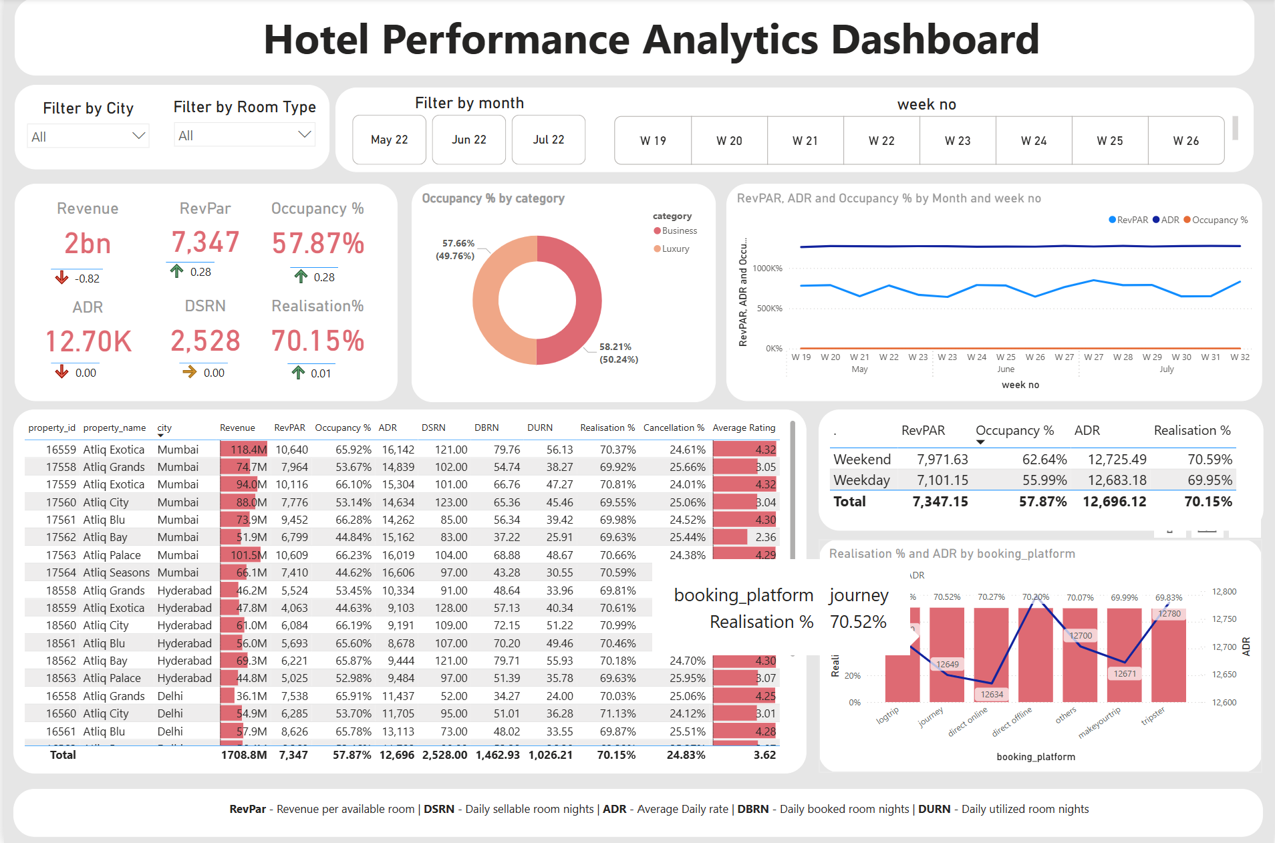
Dashboard
Screenshot

Slide 10
Business Insights
Performance Trends by City
ADR and RevPAR by Month
Mumbai and Bangalore lead in revenue generation, with Mumbai having higher occupancy but slightly lower ADR than Bangalore. Delhi has the lowest occupancy, while Hyderabad demonstrates balanced performance.
RevPAR exhibits consistent performance, indicating stable growth, while ADR shows minor fluctuations but maintains an average around 12,700.
Weekend vs Weekday Performance
Realisation % and Cancellation
Weekends have higher RevPAR and occupancy compared to weekdays, suggesting strong leisure travel demand. Weekdays require promotional strategies to boost business traveler bookings.
The overall Realisation % is healthy, but the high Cancellation % indicates an opportunity to improve booking policies, communication, and offer flexibility.
Property Insights
Average Rating
Atliq City (Delhi) requires pricing adjustments, while Atliq Exotica (Bangalore & Mumbai) are the top performers. Atliq Blu and Atliq Grands have higher customer satisfaction ratings compared to others.
The average rating across properties is 3.62, indicating moderate customer satisfaction. Properties with higher ratings require maintaining service levels, while others require improvements.

Slide 11
Conclusions and Recommendations
1
Focus on High-Performing Cities
2
Improve Weekday Occupancy
3
Reduce Cancellations
Implement flexible cancellation policies, offer rebooking incentives, and communicate reminders to reduce cancellation rates.
Invest in marketing and operational improvements in Mumbai and Bangalore to maximize revenue growth.
Introduce business-friendly packages and corporate tie-ups to boost weekday bookings.
4
Leverage Direct Online Channels
5
Improve Guest Experience
Since direct online bookings yield high realisation %, further promotion of this channel could enhance profitability.
Increase guest satisfaction by analyzing properties with low average ratings and implementing corrective actions (e.g., staff training, service upgrades).

Slide 12

Conclusion
Empower AtliQ Grands with data-driven decisions.
Drive revenue recovery and operational efficiency.

